Slide 1

Depression and Mental Health Analysis
1. Hamzah Mukadam - NUID 002741426
2. Harsh Patel - NUID 001242838
3. Sarthak Jasani – NUID 002728489
4. Shreya Maher - NUID 002770227

Slide 2
Goals
01.
02.
03.
Familiarization with Cloud Technologies:
Gain hands-on experience with Azure SQL, Cosmos DB, and other Azure services to understand the integration and management of cloud-based databases.
Pipeline Construction and Automation:
Learn to build and automate data processing pipelines using Azure Data Factory and Azure Pipelines, enhancing efficiency and reproducibility
Visualization and Analytics Mastery:
Utilize Tableau to create meaningful visualizations that can provide insights into mental health trends and patterns.

Slide 3
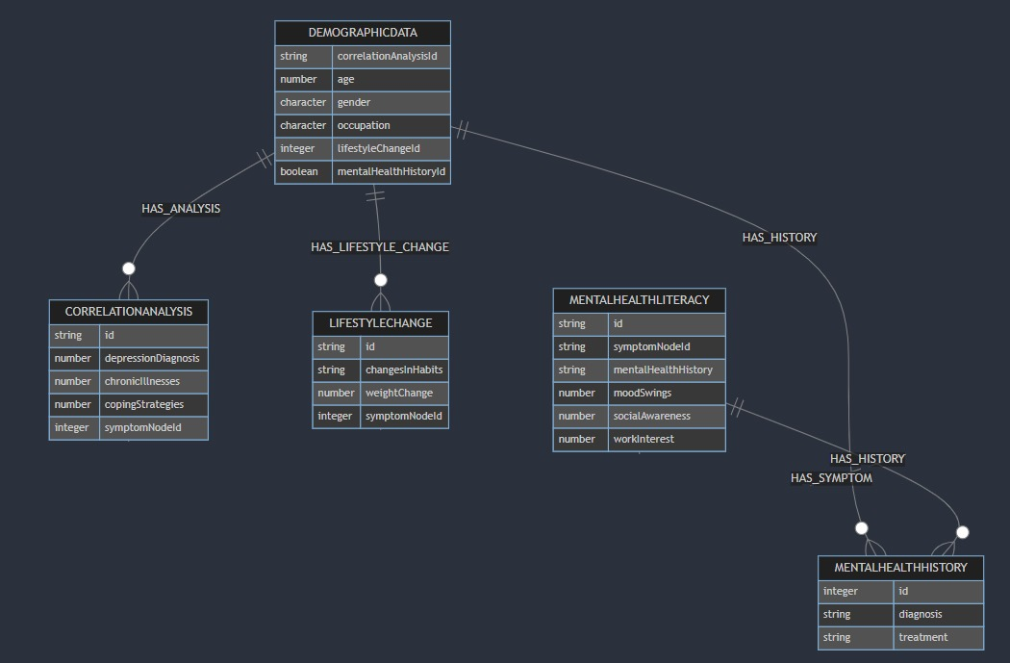
ER Diagram (Relational + Document)
Document

Slide 4
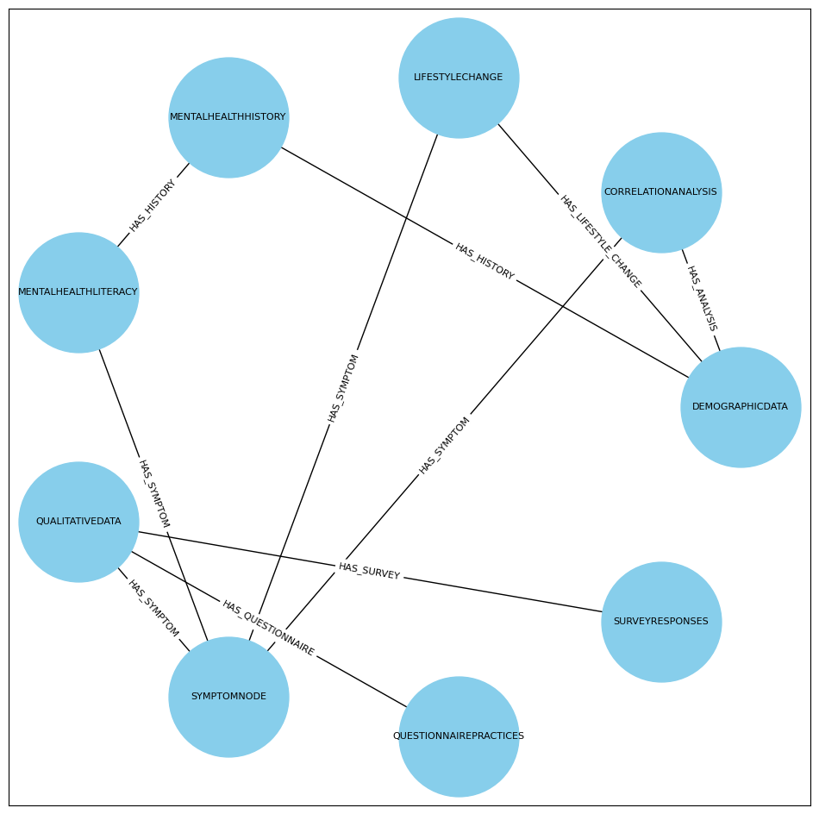
ER Diagram (Graph)

Slide 5
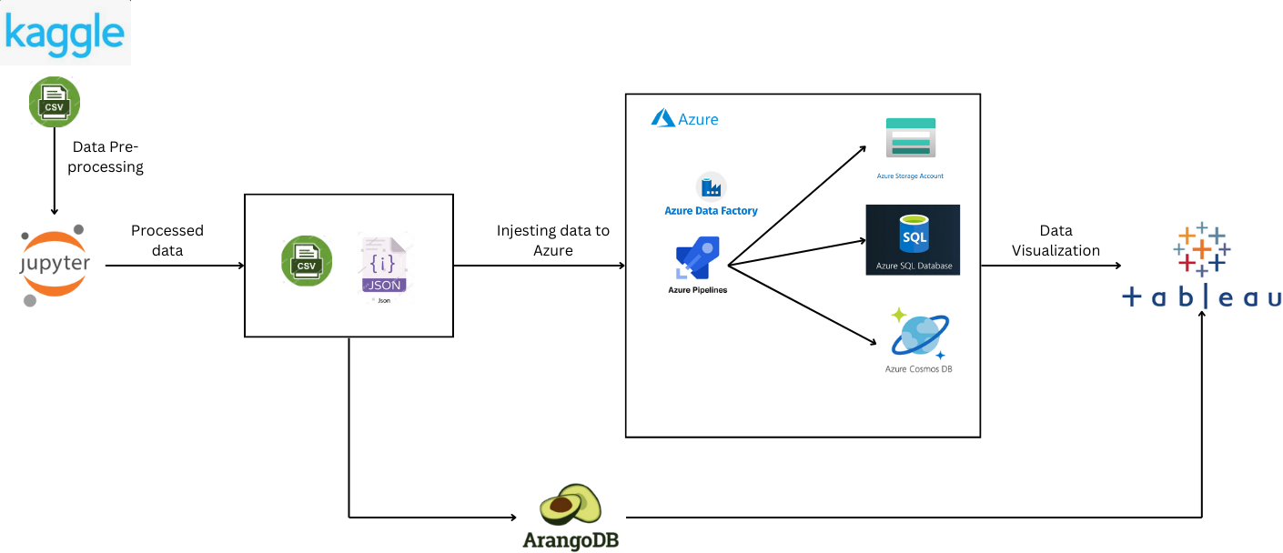
Architecture Diagram

Slide 6
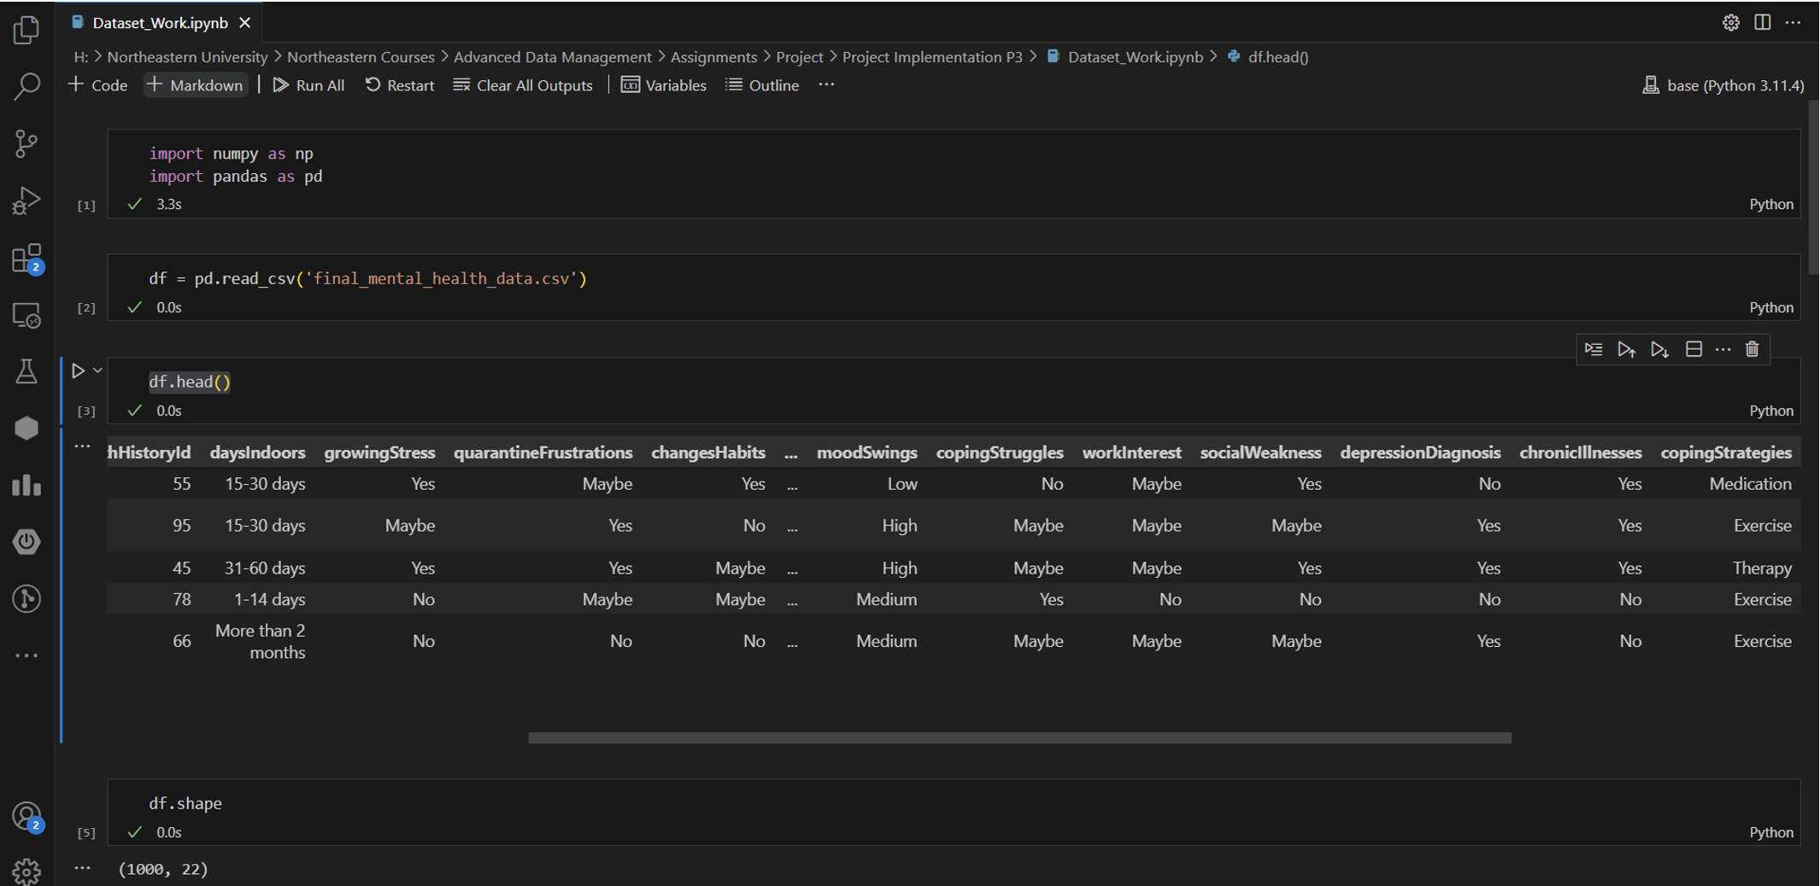
Data Collection and Preprocessing
We sourced our data from Kaggle and used Jupyter Notebooks for preprocessing.
Steps included:
Cleaning data for inconsistencies (duplicates)
Handling missing values (null values)
Normalizing data for analysis

Slide 7
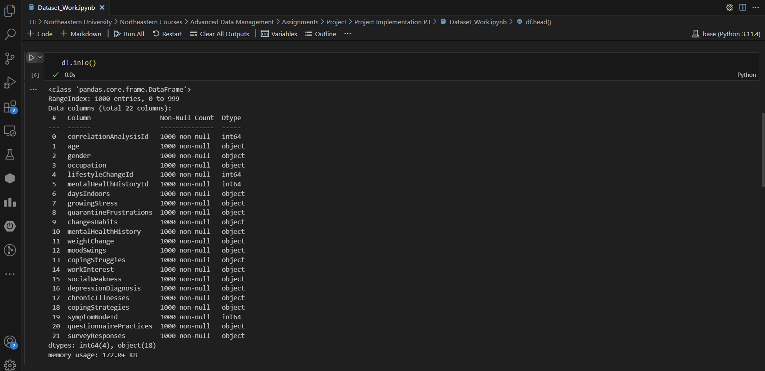
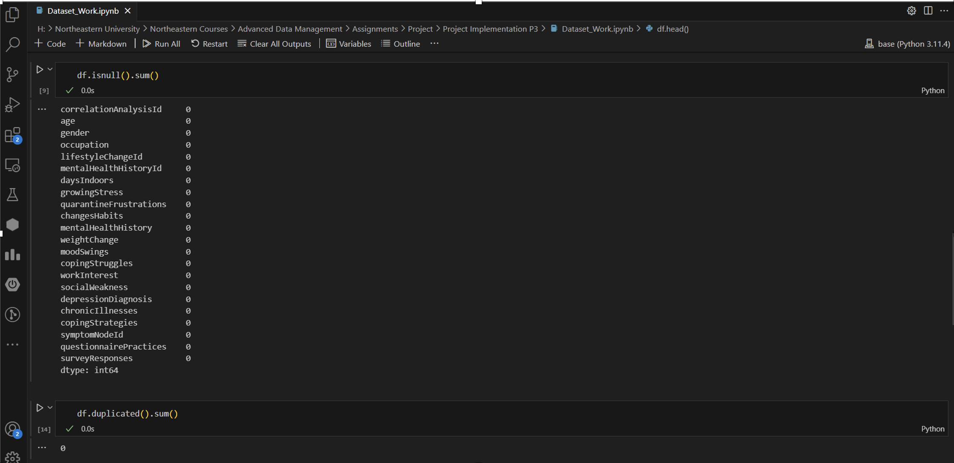
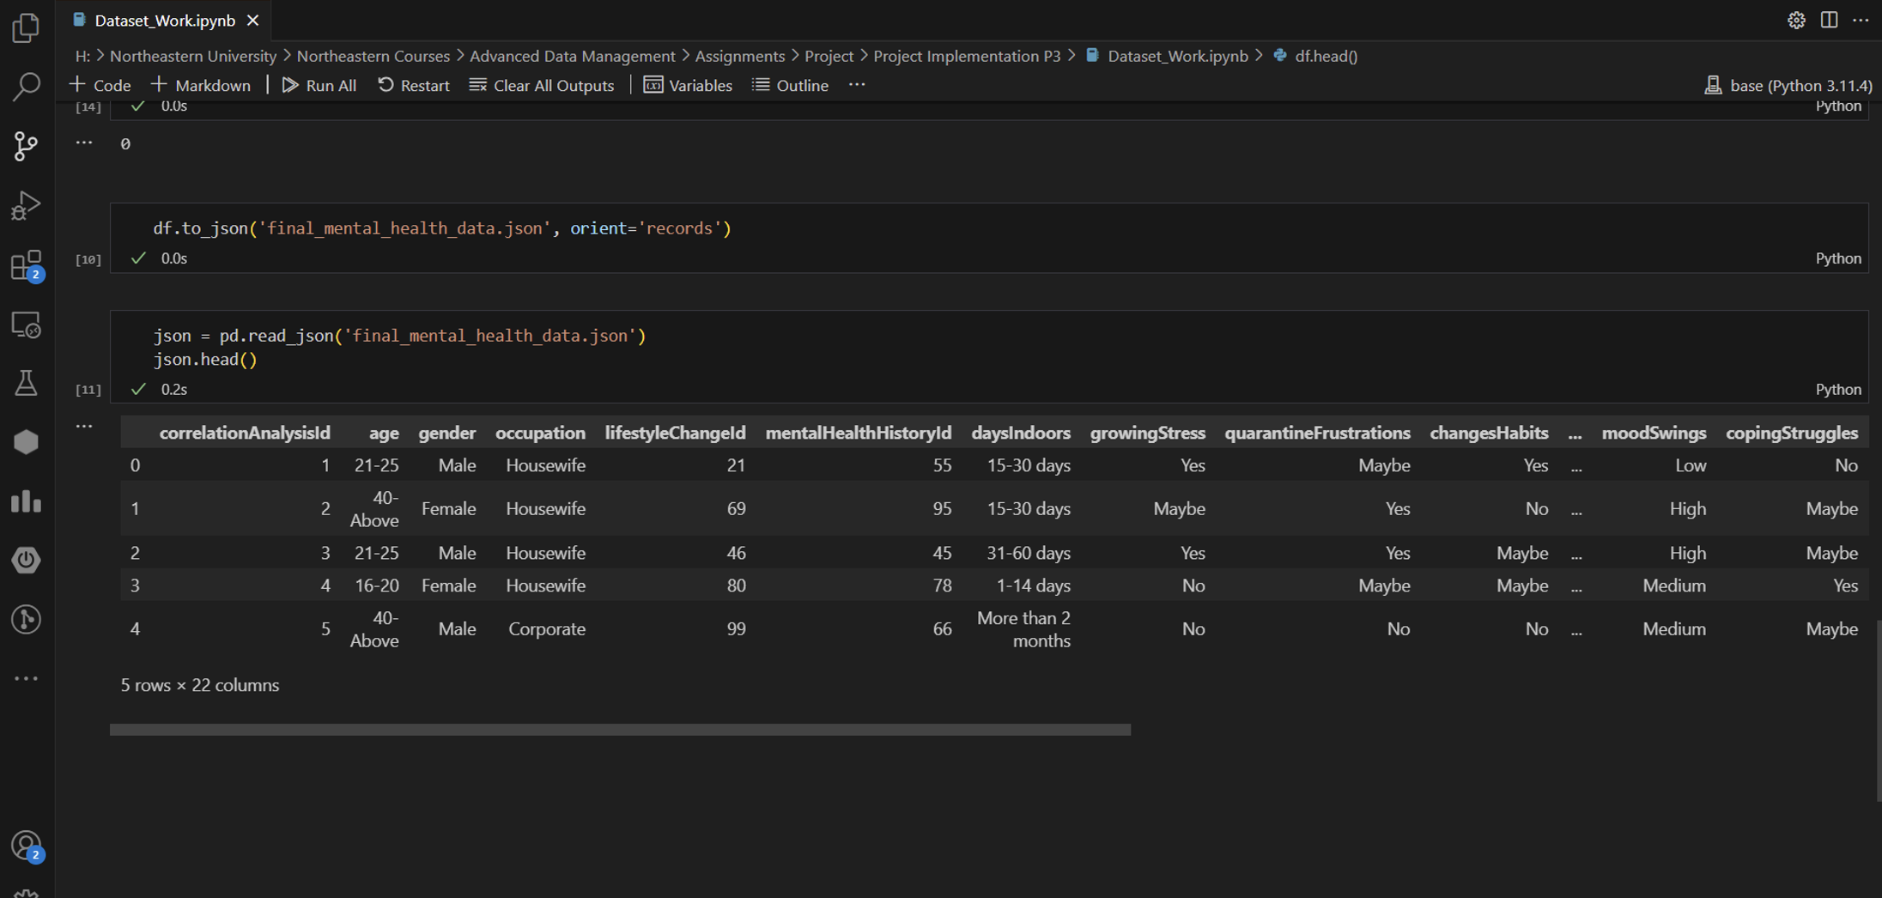

Slide 8
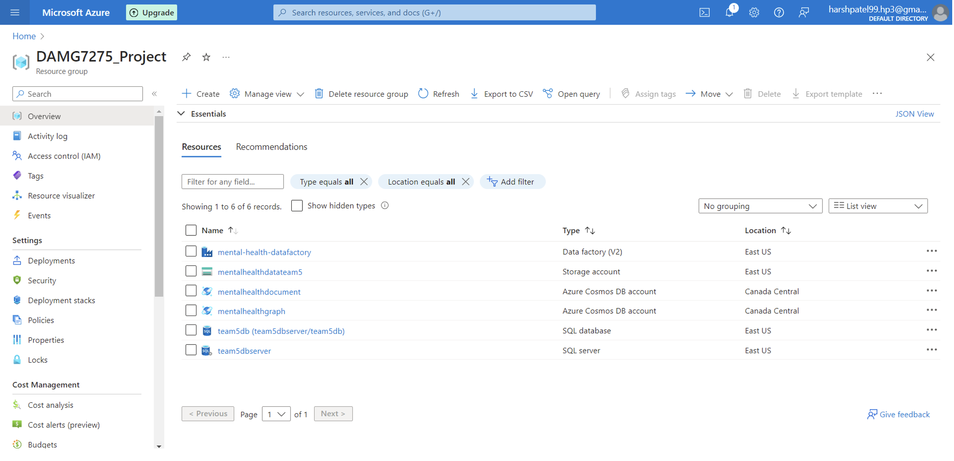
Azure Resources

Slide 9
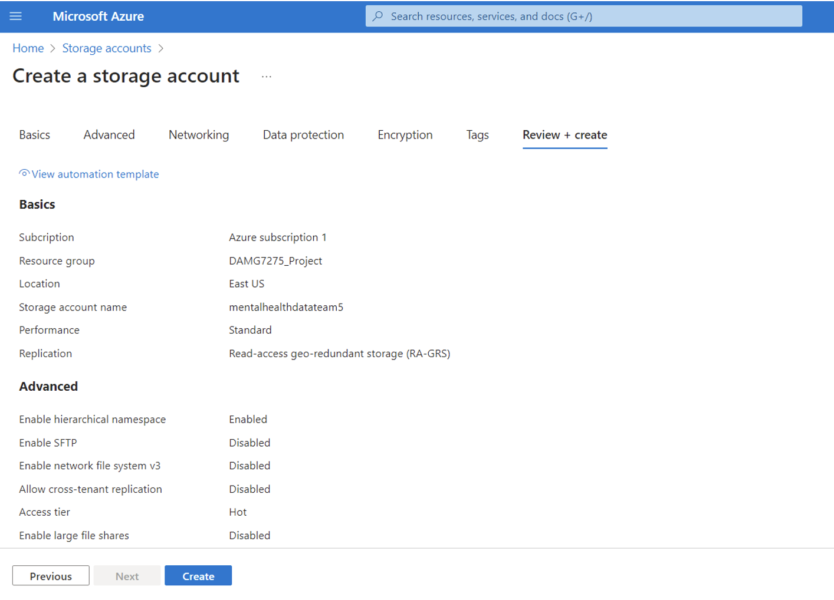
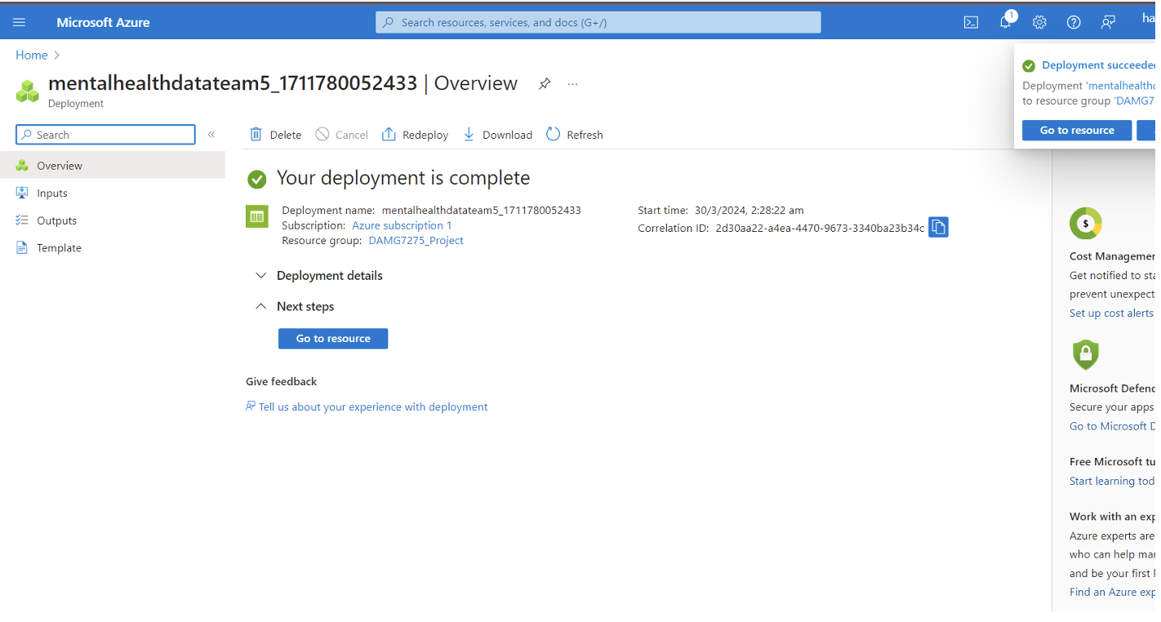
Azure Storage Account

Slide 10
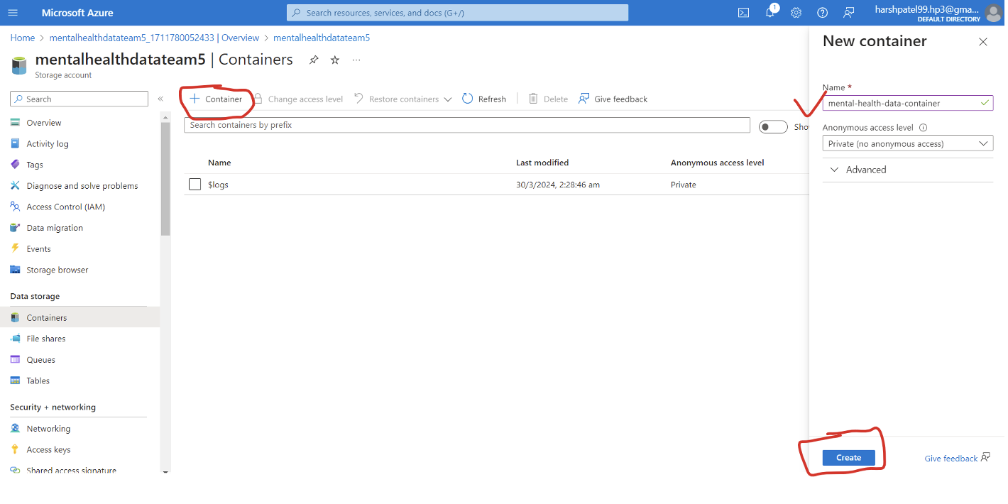
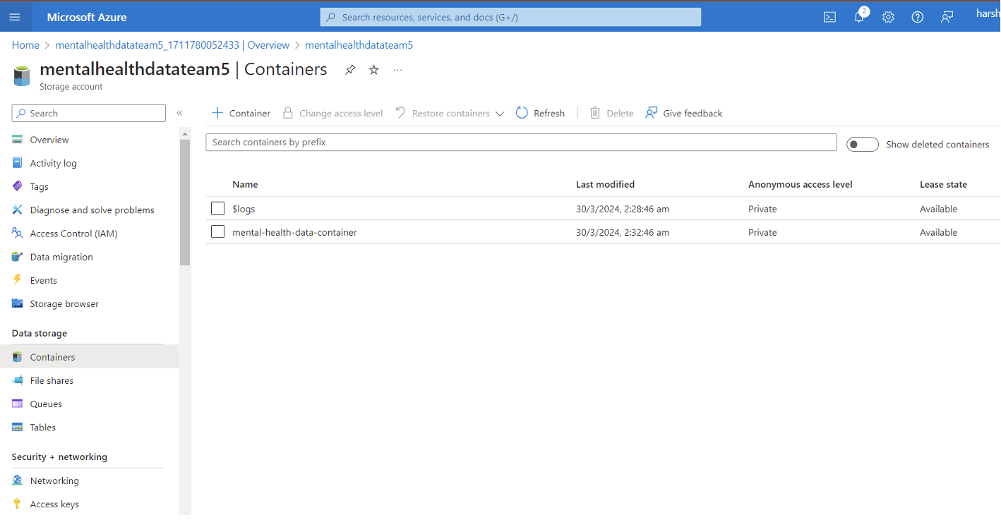
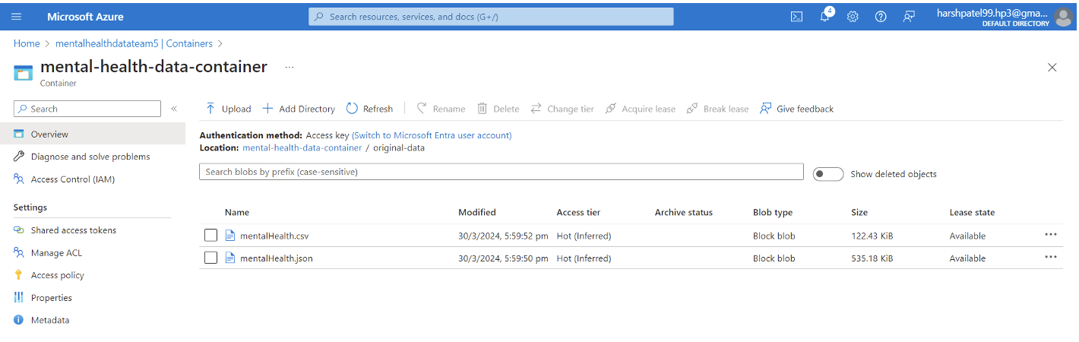

Slide 11
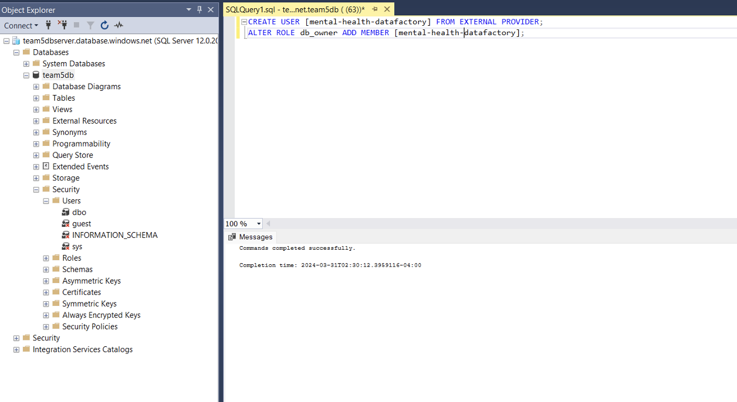
Azure SQL Database
SQL Database
Created SQL Database and server service in our resource group to later use it.
Now connecting this service to datafactory requires several steps
Server service -> networking -> selected networks -> add the users ip address -> check the allow azure services checkbox
Open SSMS, connect to the server service using servername and write the below query to add user and its role as db_owner for all access.

Slide 12
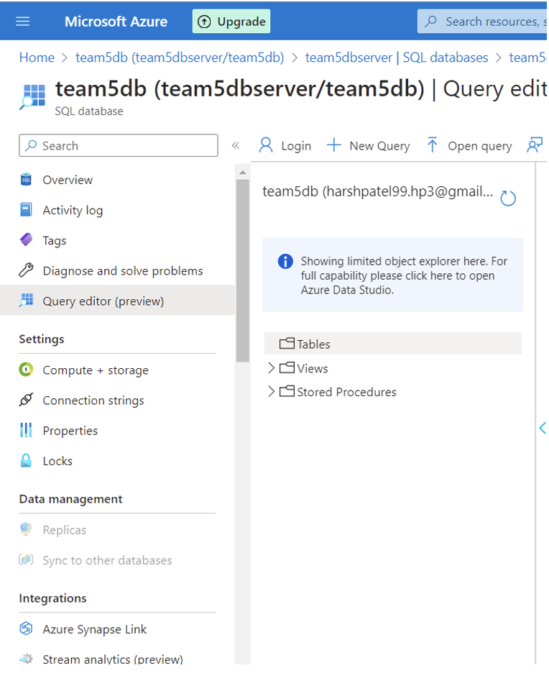
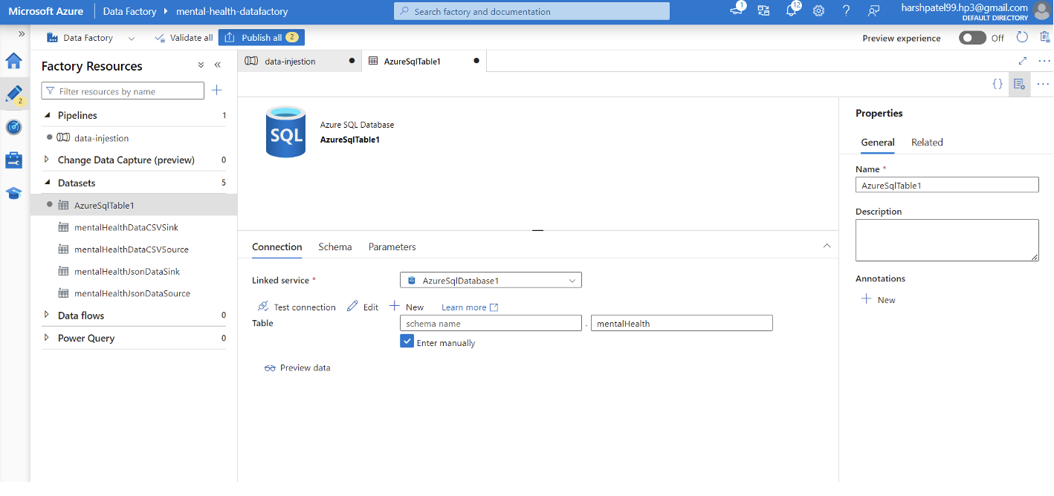

Slide 13
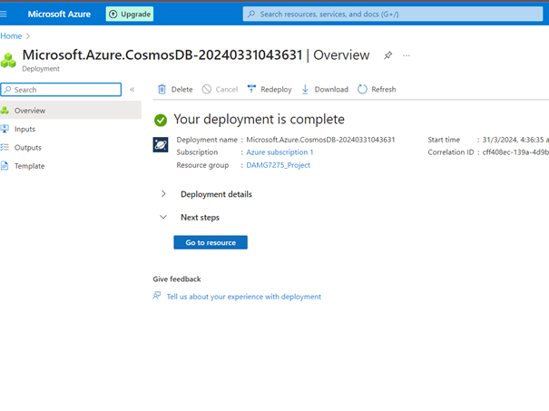
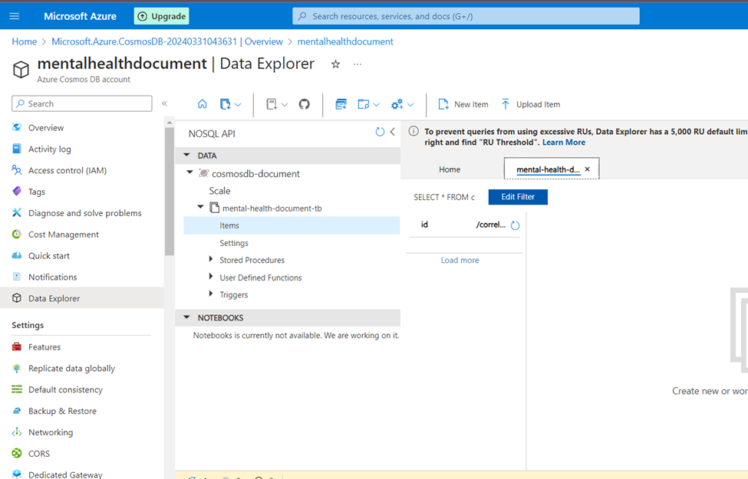
Azure CosmosDB

Slide 14
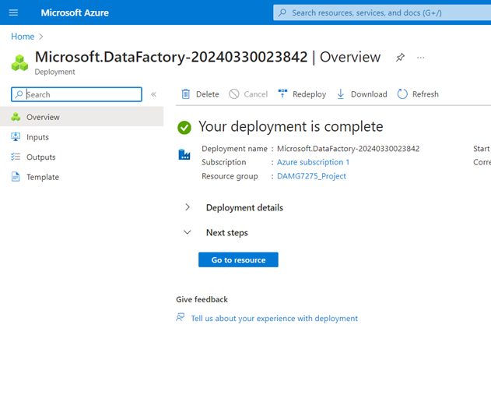
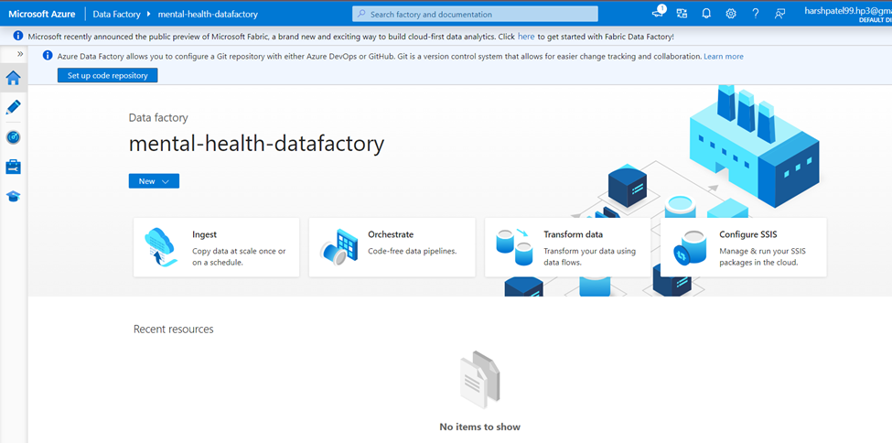
Azure Data Factory

Slide 15
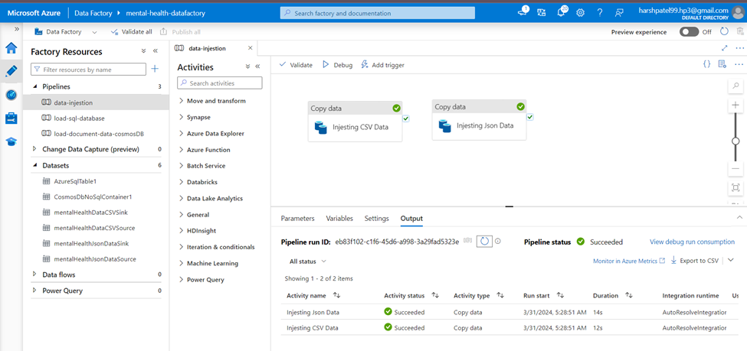
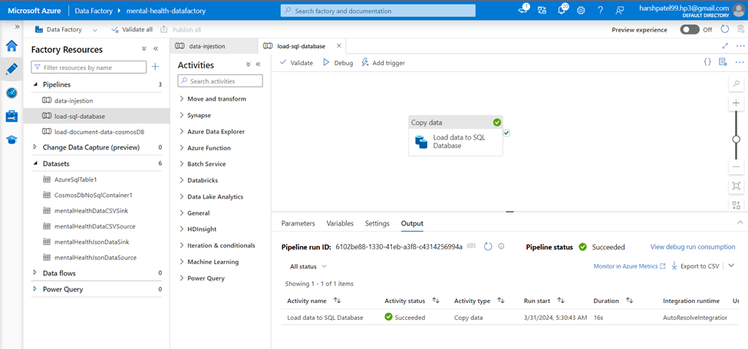
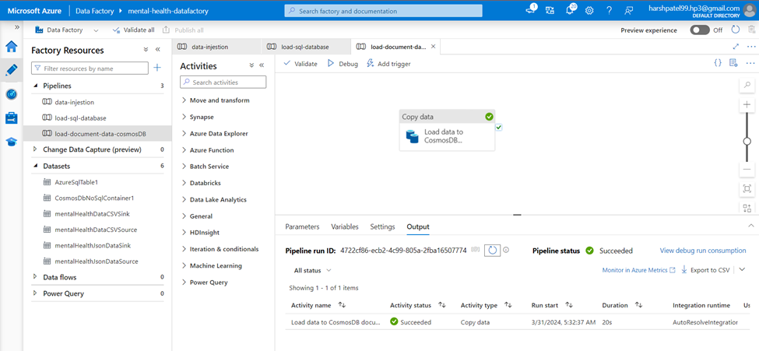
Azure Data Pipelines

Slide 16
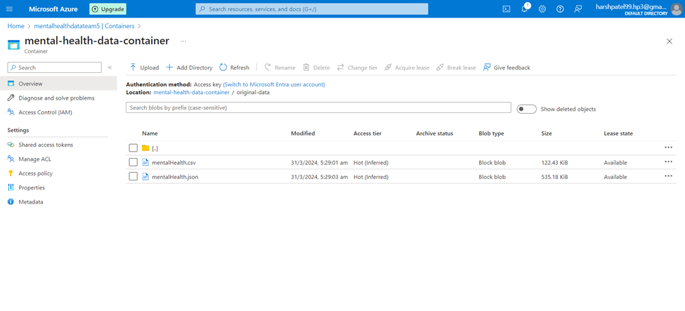
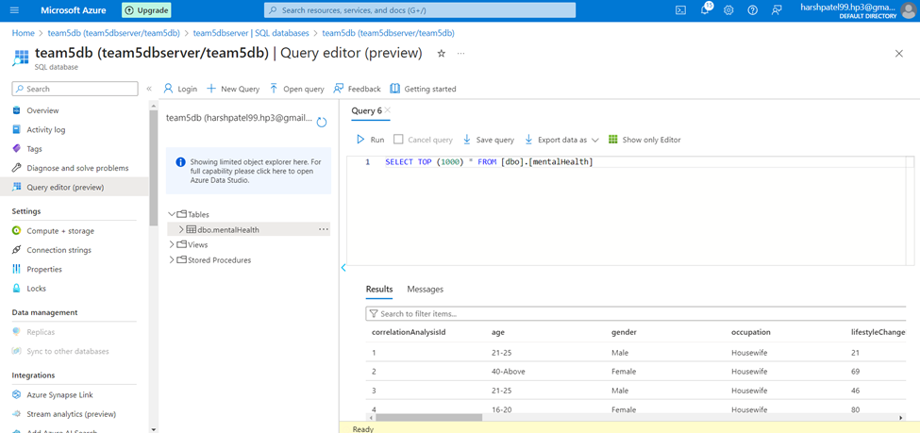
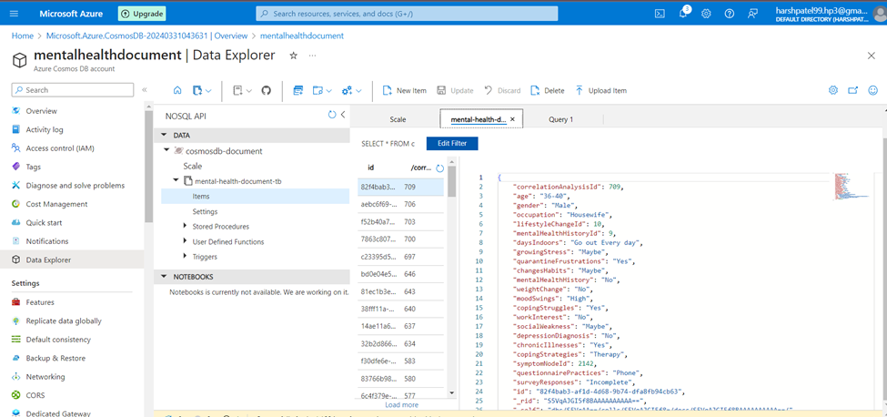
Azure Data Pipelines Result

Slide 17
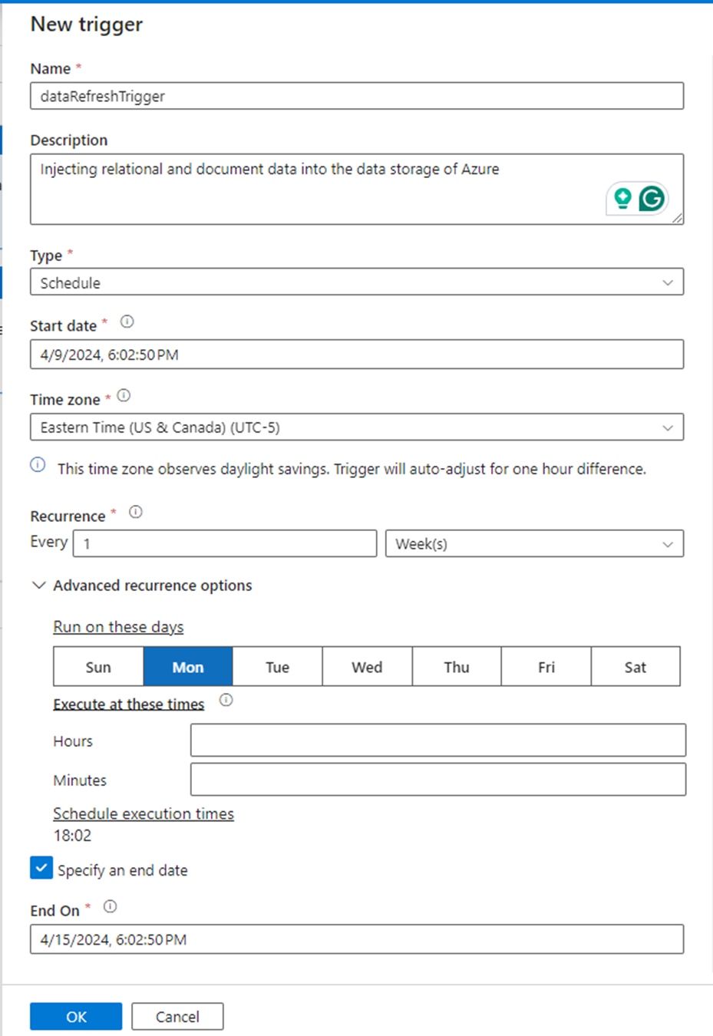
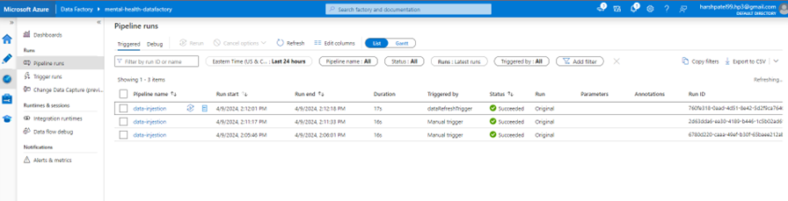
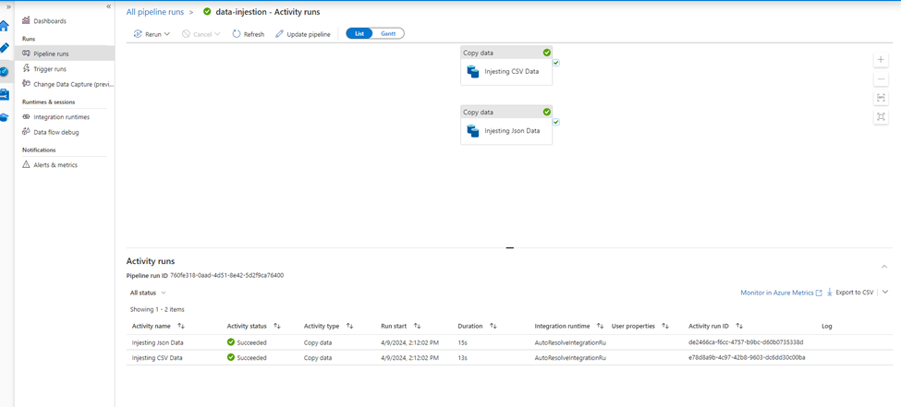
Azure Data Pipelines (Data Refresh Triggers)

Slide 18
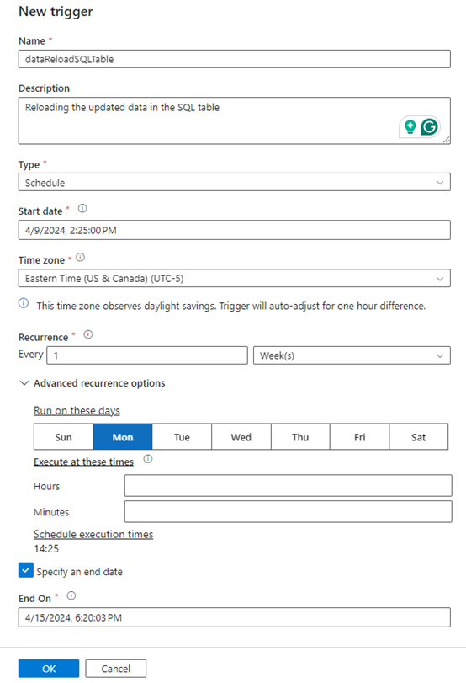
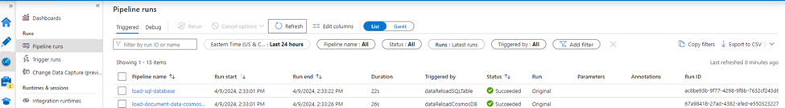
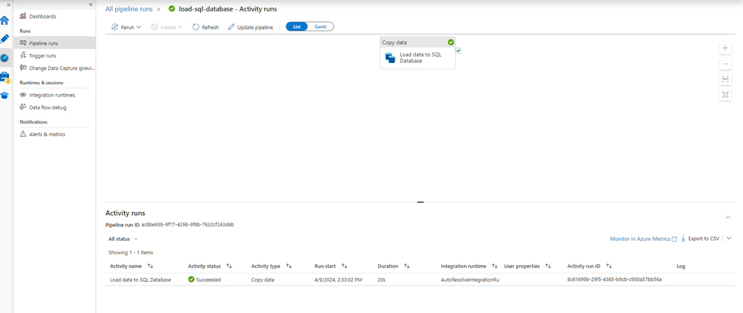
Azure Data Pipelines (Data Refresh Triggers)

Slide 19
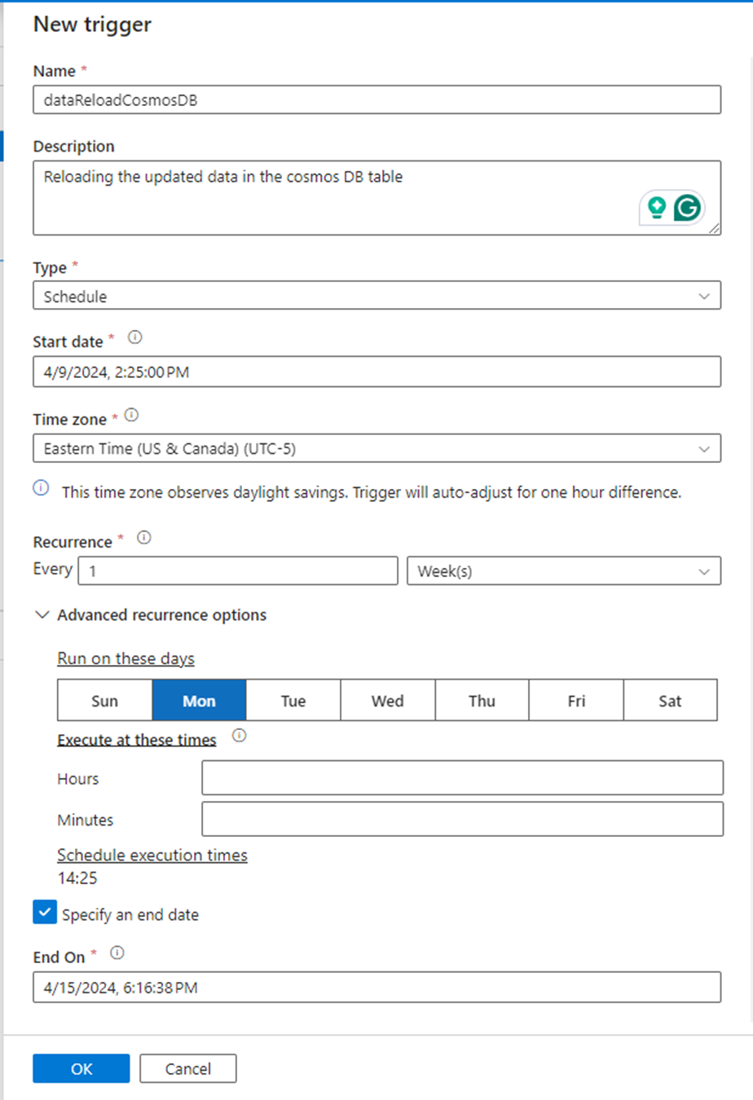
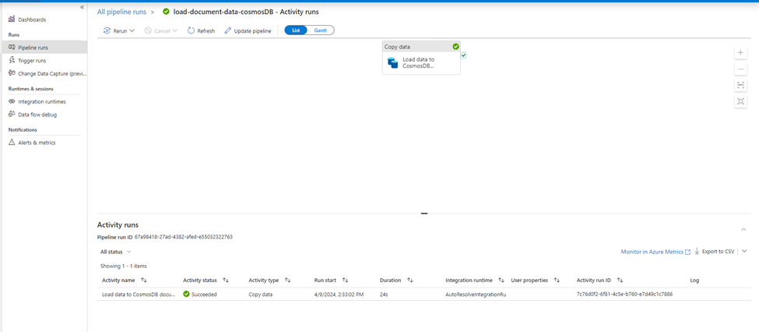
Azure Data Pipelines (Data Refresh Triggers)

Slide 20
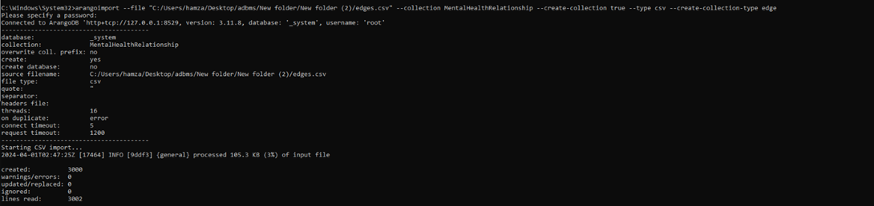
ArangoDB
Creating collection in Arango db
Vertex: arangoimport --file "C:/Users/hamza/Desktop/adbms/New folder/New folder (2)/vertices.csv" --collection MentalHealthVertices --create-collection true --type csv
Edge: arangoimport --file "C:/Users/hamza/Desktop/adbms/New folder/New folder (2)/edges.csv" --collection MentalHealthRelationship --create-collection true --type csv --create-collection-type edge

Slide 21
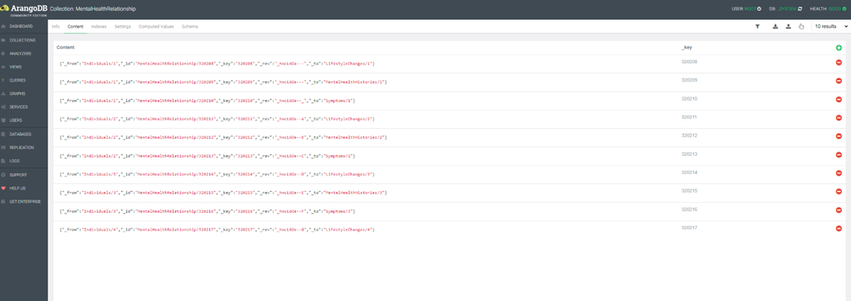
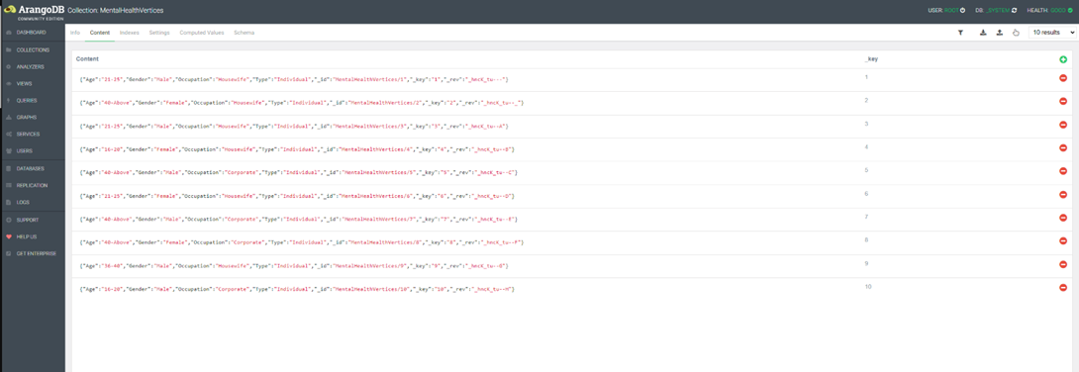
ArangoDB
Vertex Collection
Edge Collection

Slide 22
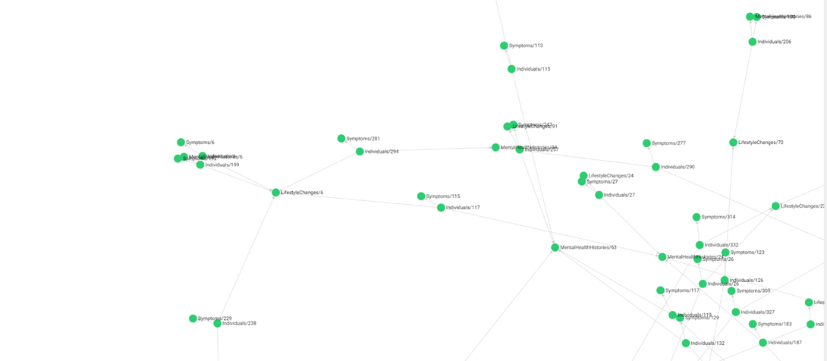
ArangoDB
Visualizing Graph

Slide 23
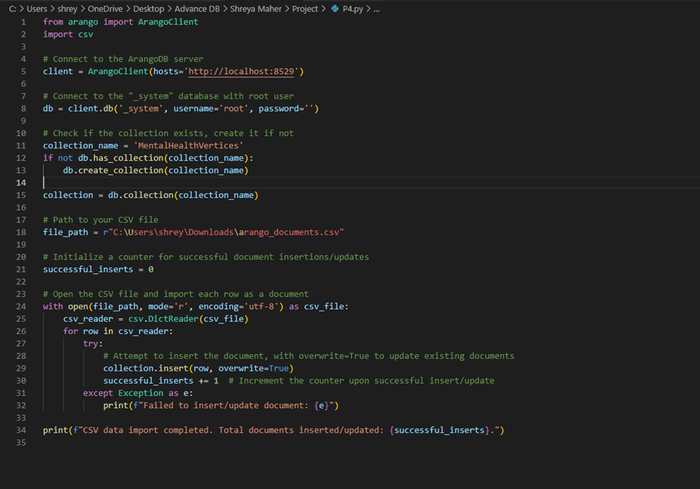
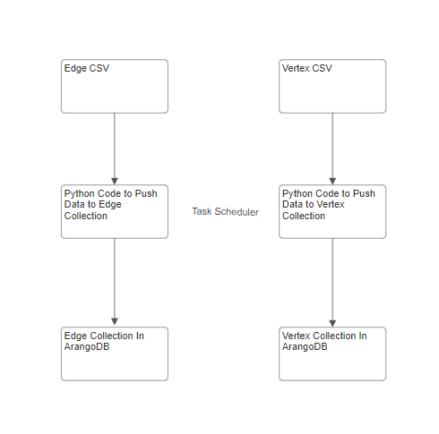
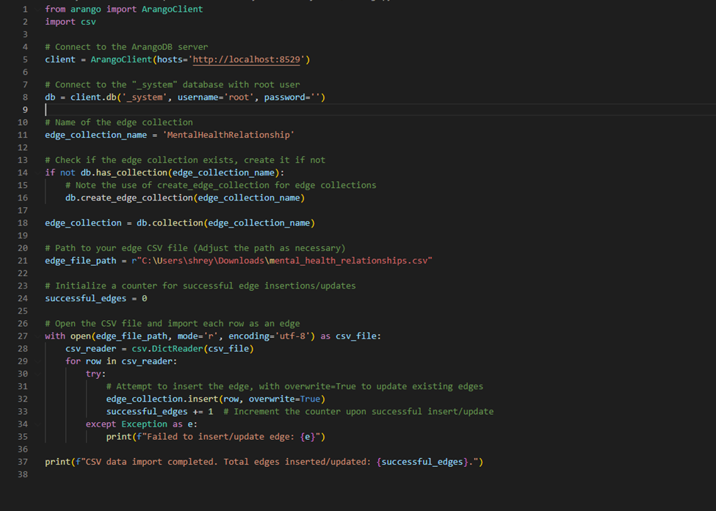
ArangoDB
Auto Refresh For Data

Slide 24
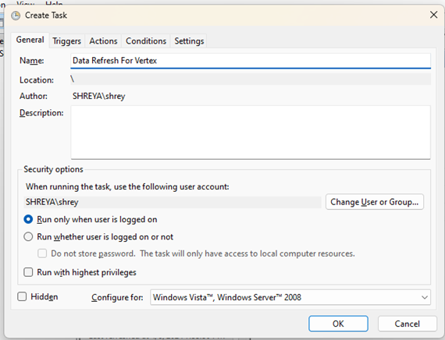
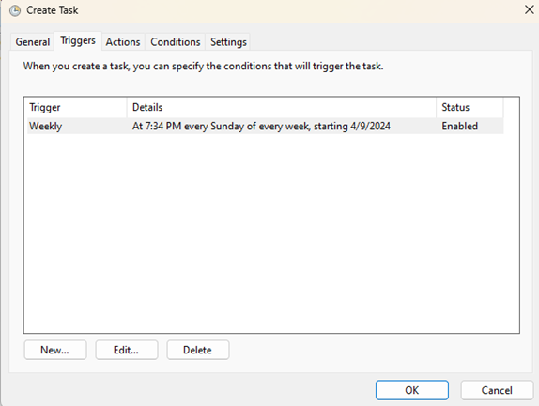
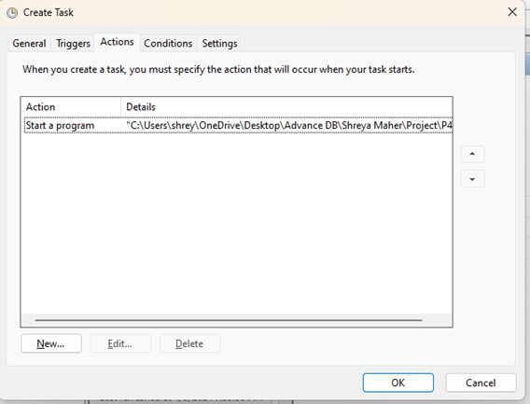
ArangoDB
Auto Refresh For Data

Slide 25
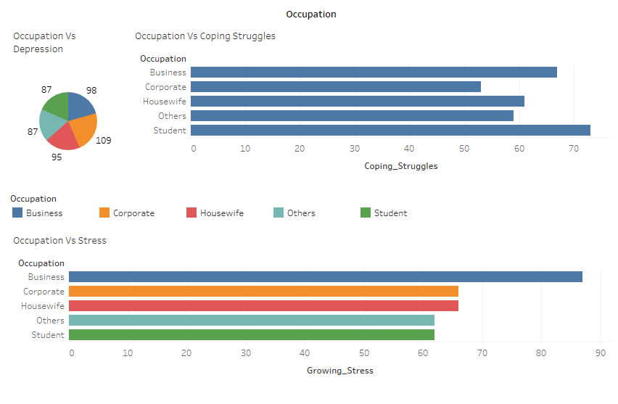
Tableau Visualization
Students: Their highest coping struggles might be due to academic pressures, uncertainty about future prospects, and adapting to remote learning or changes in their educational environment due to quarantine. Students might have limited life experience and resources to deal with such unprecedented situations, leading to greater difficulties in coping.
Business Professionals: The highest stress levels reported by business professionals could stem from the responsibility to maintain business operations during uncertain economic times, the stress of potential financial loss, or the challenge of adapting business models to fit new market conditions imposed by the quarantine.

Slide 26
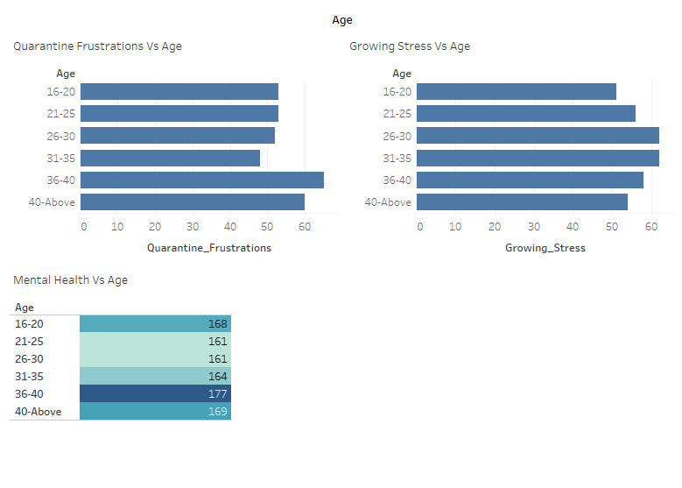
Tableau Visualization
The relationship between high quarantine frustrations and high mental health issues, particularly in the 36-40 age group and those aged 40 and above, suggests a correlation where increased frustrations due to quarantine may be contributing to or coinciding with a rise in mental health issues in these age groups

Slide 27
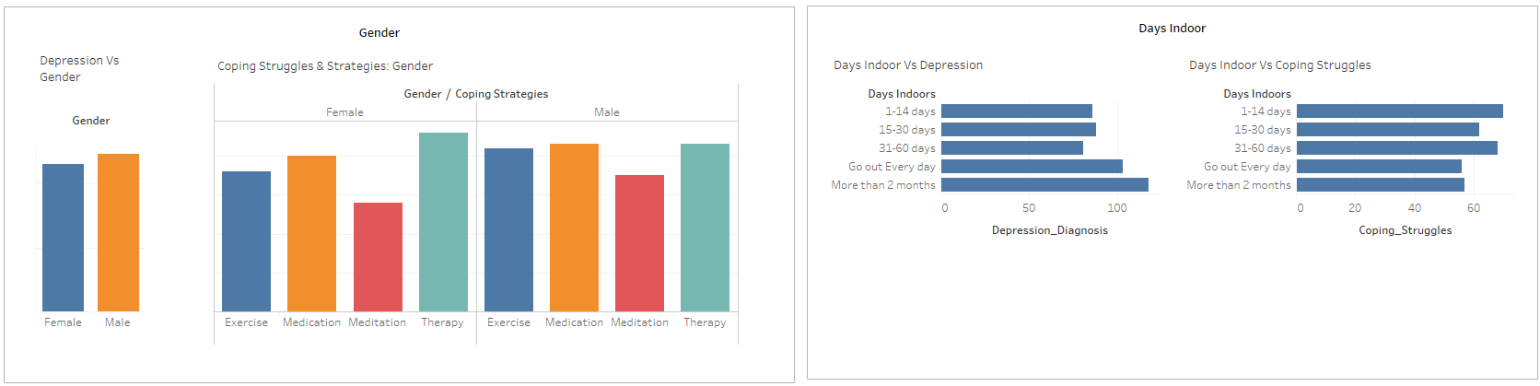
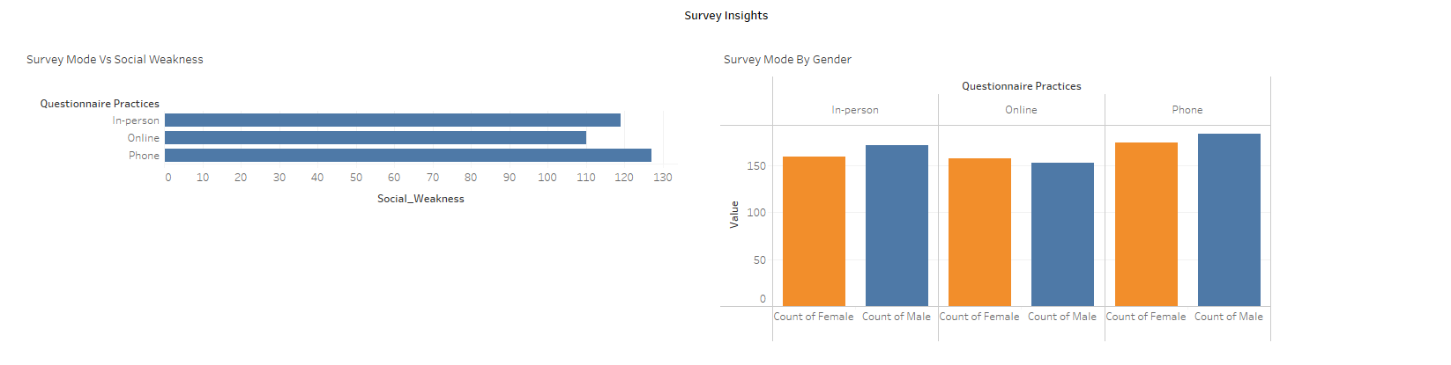
Tableau Visualization

Slide 28
Conclusion
Learned to use cloud-based data ingestion with Azure Data Factory for streamlined workflow.
Gained hands-on experience in setting up and managing Azure Pipelines for data automation.
Understood the application and management of data in both Azure SQL Database and Azure Cosmos DB.
Explored the flexibility of ArangoDB for complex data structure management.
Developed skills in data visualization and analytics with Tableau to make data-driven insights accessible.
Acquired practical knowledge of building a full data pipeline from processing to visualization.
Recognized the importance of multi-model databases and cloud services in the healthcare data analytics domain.

Slide 29

Thank you very much!

